Slide 1
WP2 - Environment Mapping and Self-localisation
SPRING - Presentation
Winter School
February 22, 2024
by CTU in Prague
Notes:
Dear colleagues, I am MIchal Polic a researcher from CVUT, the institute Czech Institute of Informatics, Robotics and Cybernetics.
I have finished my doctoral study 4 months ago while working on SPRING project.
In this presentation, I will show an overview of the work done to localize the robot and create a digital copy of the environment ARI is working in.

Slide 2
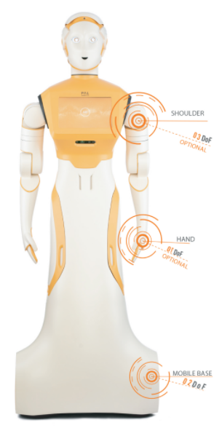
Environment Mapping and Self-localisation
Objectives
Develop models, representations and algorithms for building and upgrading environment map with semantic annotations to support data simulations and robot self-localization.
Outcomes
Audio and visual data simulation
Robust localization from images
Tracking of robot pose in real time
Scene representation for localization, mapping, and environment understanding
Notes:
The overall objectives of this work package are to develop models, representations and algorithms for building and upgrading environment map suitable for the real world understanding and robot localization.
The outcomes are:
The datasets and scripts to simulate the robot working in hospital environment.
The scene representation for localization, mapping, and robot scene understanding,
robust and accurate localization software,
and integration of simulation frameworks for the robot operation in the real environment.

Slide 3
Environment Mapping and Self-localisation
Objectives
Develop models, representations and algorithms for building and upgrading environment map with semantic annotations to support data simulations and robot self-localization.
Outcomes
Audio and visual data simulation
Robust localization from images
Tracking of robot pose in real time
Scene representation for localization, mapping, and environment understanding
Notes:
The overall objectives of this work package are to develop models, representations and algorithms for building and upgrading environment map suitable for the real world understanding and robot localization.
The outcomes are:
The datasets and scripts to simulate the robot working in hospital environment.
The scene representation for localization, mapping, and robot scene understanding,
robust and accurate localization software,
and integration of simulation frameworks for the robot operation in the real environment.

Slide 4
Simulation
Localization
Tracking
Mapping
Understanding
Data collection
Mapping of the environment
(Matterport)
Simulation of robot tasks
(AI Habitat)
Simulation of dynamic environment
(D-InLoc++)
Simulation of environment specific objects
(MyGYM)
Notes:
To simplify the complex task that has to be accomplished, I will split it to five smaller tasks.
The fist is the simulation of hospital environment and robot moving in it.
Next task focus on getting the initial pose of ARI in large scale map of a hospital.
The tracking use the initial pose and track the camera pose in real time.
Mapping is step of building a map out of the images captured by ARI.
The last task focus on the scene segmentation, description of relationships, etc. .
Regarding the simulation. We have collected data in the hospital when it was empty and use this data to compose various datasets.,

Slide 5
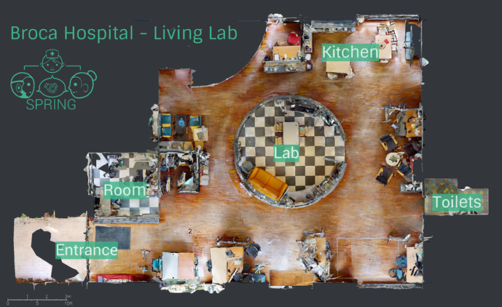
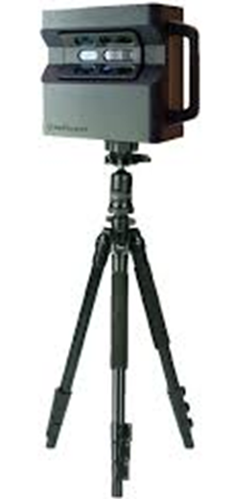
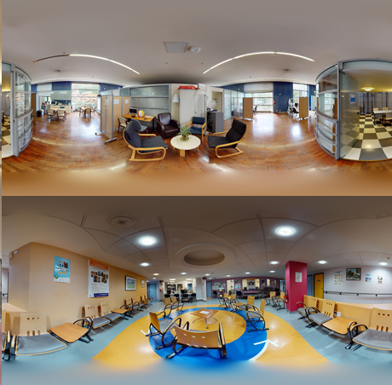
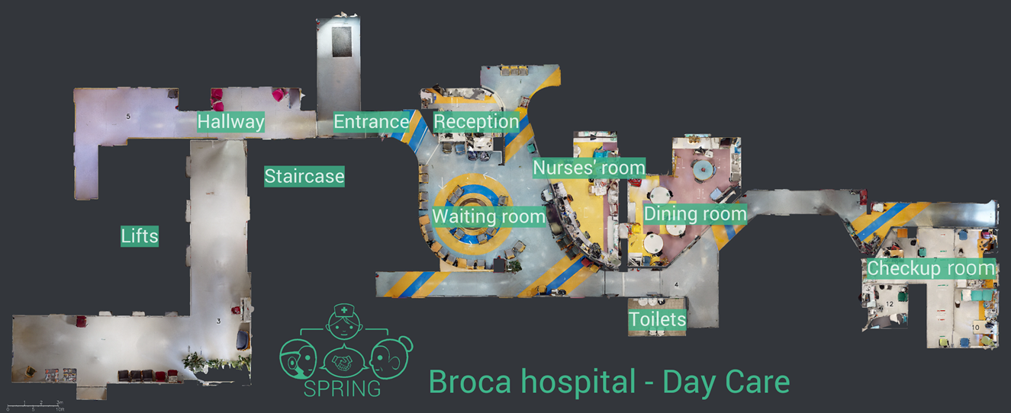
Simulation
Localization
Tracking
Mapping
Understanding
ARI cannot record patients, we cannot run all experiments in hospital (COVID19)
150+ of 360 deg RGB-D scans of hospital environment composed to dense model by Matterport

Slide 6
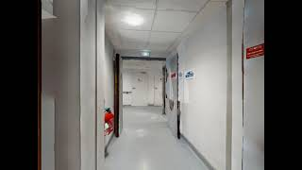
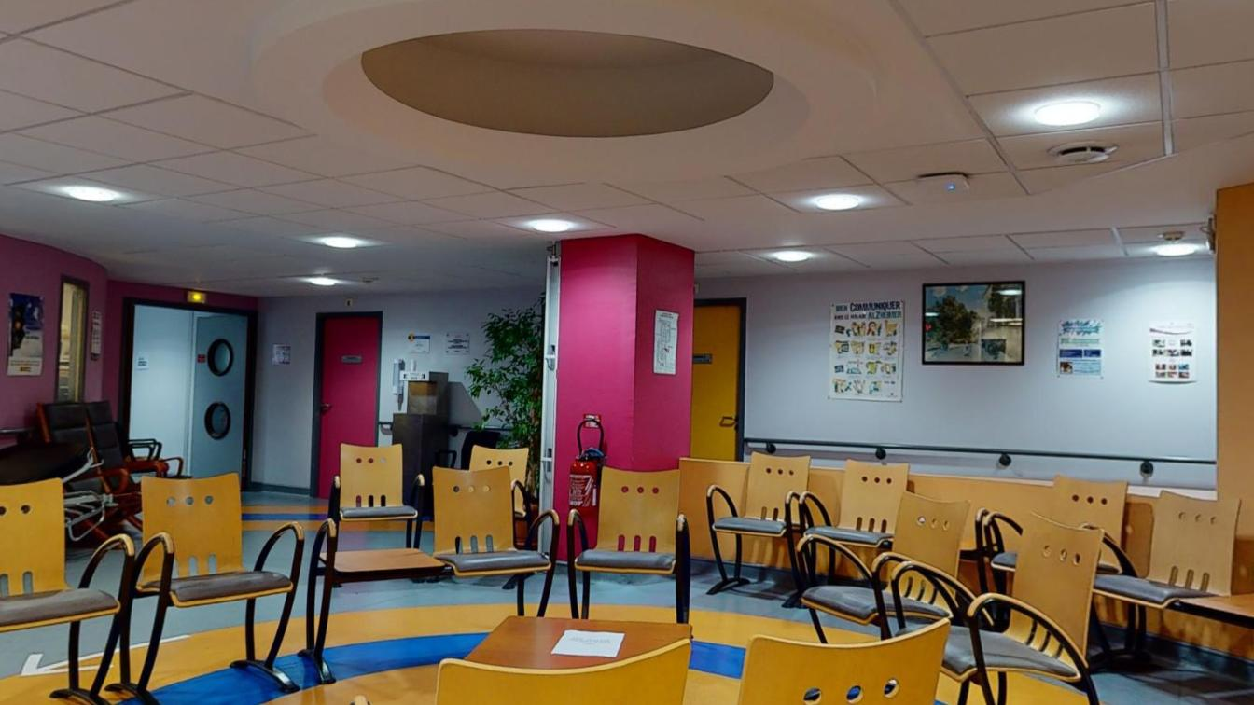
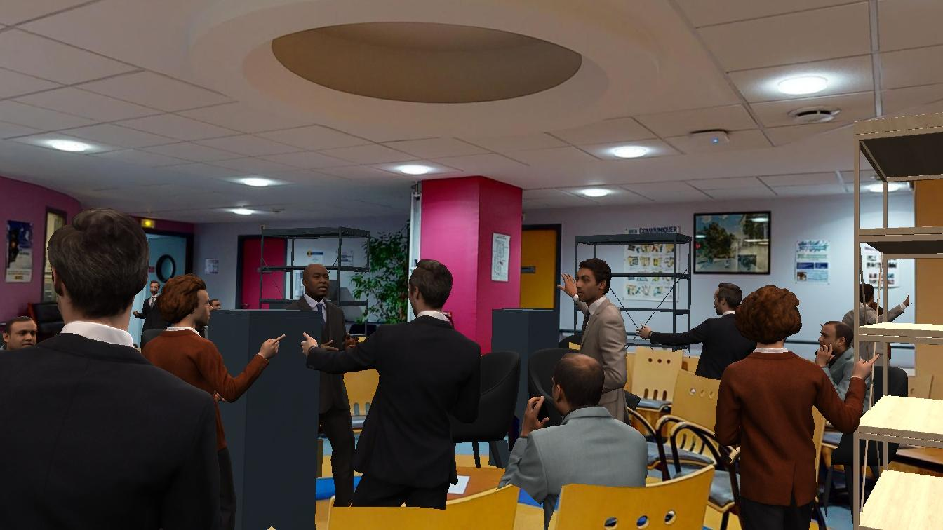
Simulation
Localization
Tracking
Mapping
Understanding
Simulation of robot moving in hospital
Training data for segmentation
Hospital model
(Matterport)
Robot simulation
(AI Habitat)
Localization map
(dynamic environments)
DATA

Slide 7
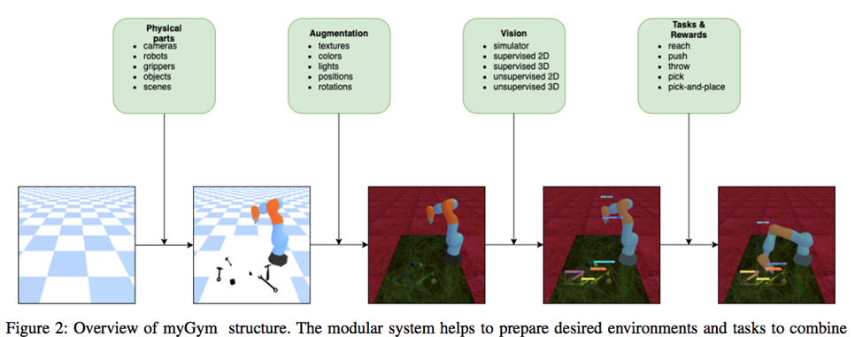
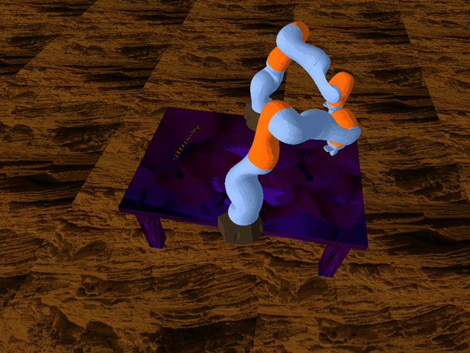
Simulation
Localization
Tracking
Mapping
Understanding
Training data for robust 2D segmentation
Object models
(Reality Capture)
Manipulation simulation
(MyGYM)
DATA
YOLACT segmentation on hospital images

Slide 8
Simulation
Localization
Tracking
Mapping
Understanding
Dense localization
Sparse localization
Image retrieval
InLoc
Hierarchical localization
NetVLAD
D-InLoc++
SENet
(Image retrieval)
SENet
Semantic InLoc
Multiview localization
The localization task is a process of finding the initial pose in large scale map of the environment
ARI localization: SENet + Hierarchical localization + Multiview localization

Slide 9
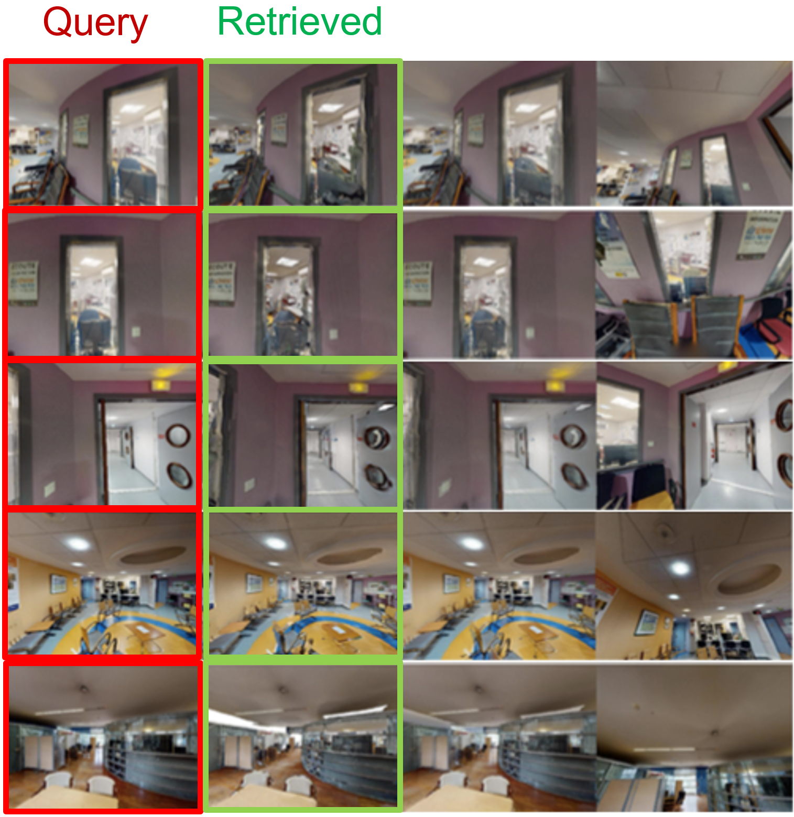
Simulation
Localization
Tracking
Mapping
Understanding
InLoc evaluation on hospital dataset (dense localization)
Candidate poses are verified using rendered images by AI Habitat
- Image retrieval (100 top)
- Sparse verification (10 top)
- Dense verification (reorder 10 top)
Denese verification of est. camera poses (InLoc)

Slide 10
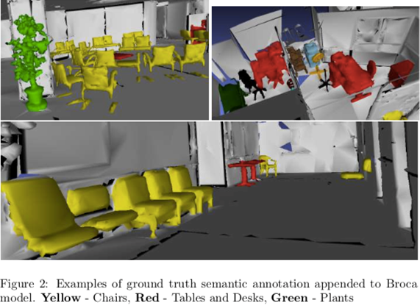
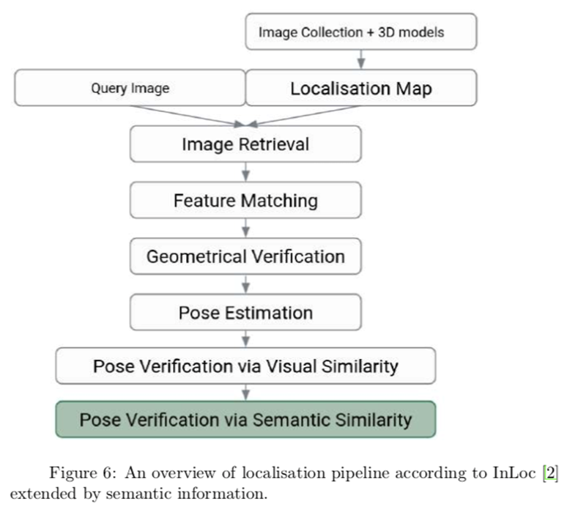
Simulation
Localization
Tracking
Mapping
Understanding
InLoc + semantic localization extension
Masks of segmented objects (AI Habitat)
Segmentation of query images (YOLACT)
Sparse verification
Dense verification

Slide 11
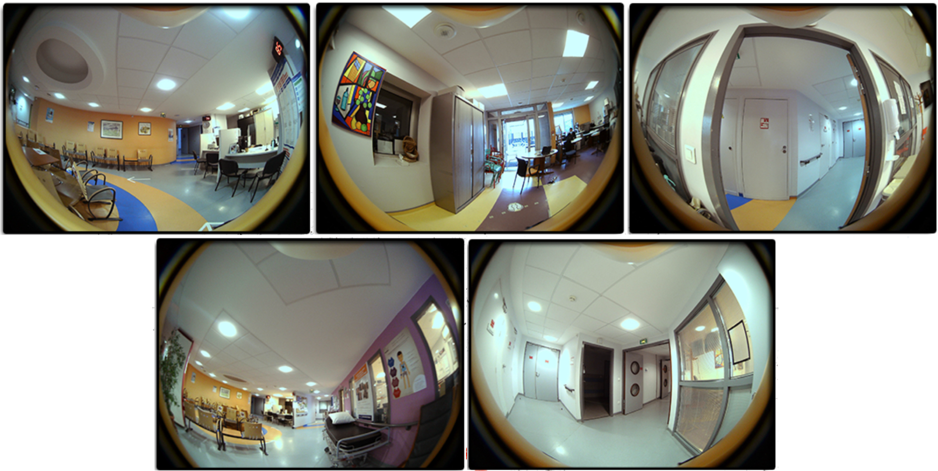
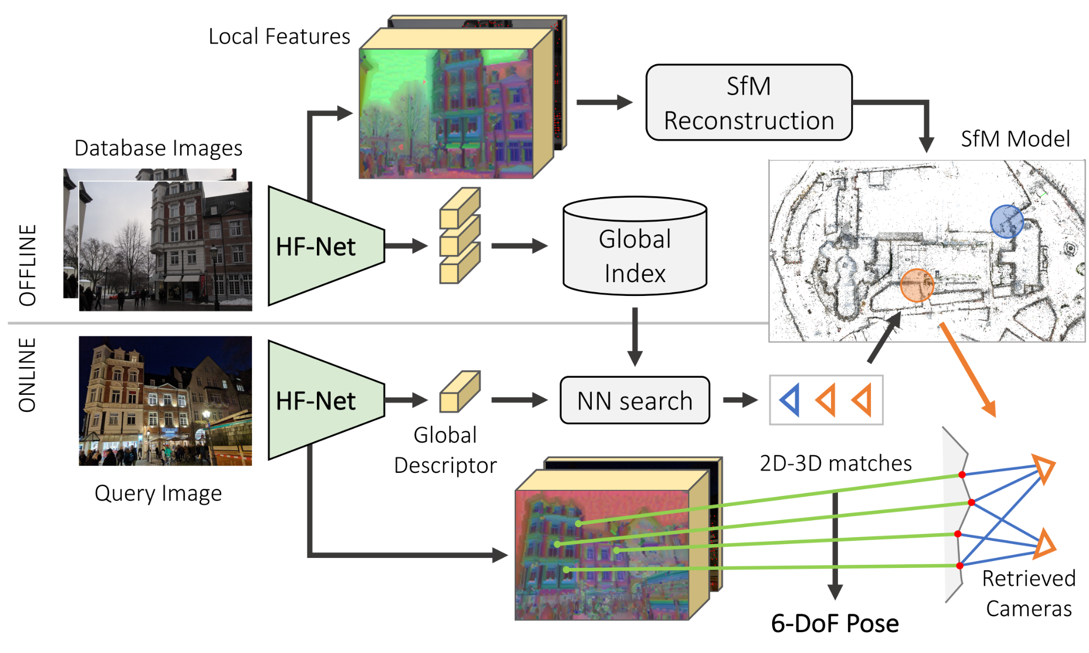
Simulation
Localization
Tracking
Mapping
Understanding
Hierarchical localization (sparse localization)
Example of hospital images captured by ARI
Sarlin, Paul-Edouard, et al. "From coarse to fine: Robust hierarchical localization
at large scale.
Sparse 3D map of the hospital environment created by SfM

Slide 12
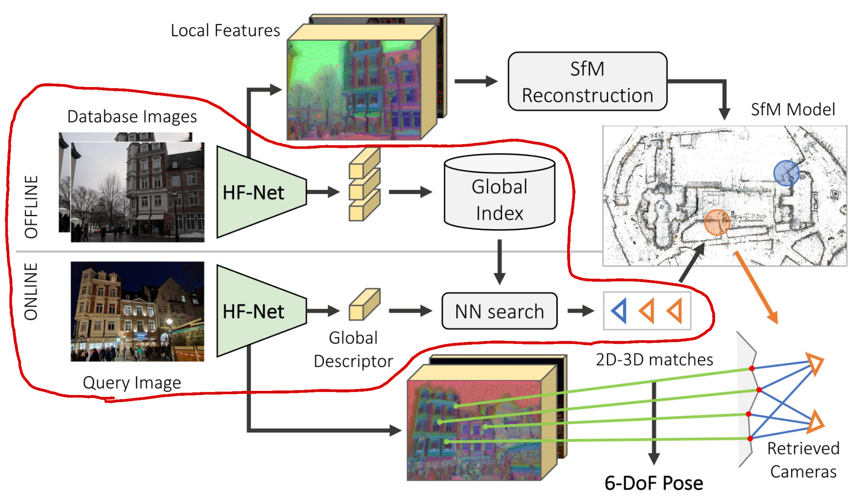
Simulation
Localization
Tracking
Mapping
Understanding
SENet + Hierarchical localization
Image retrieval
Example of hospital images captured by ARI
Sarlin, Paul-Edouard, et al. "From coarse to fine: Robust hierarchical localization
at large scale.
Sparse 3D map of the hospital environment created by SfM

Slide 13
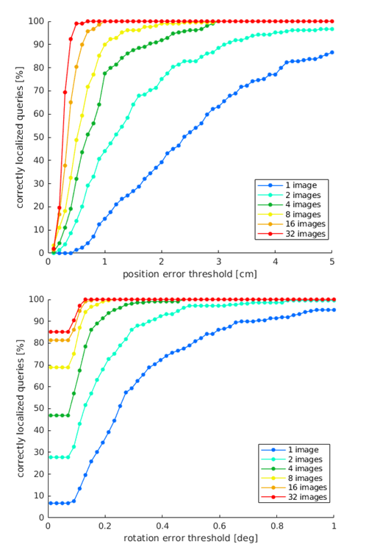
Simulation
Localization
Tracking
Mapping
Understanding
SENet + Hierarchical localization + Multiview localization
Hierarchical localization of a query image
Hierarchical localization of query images

Slide 14
Simulation
Localization
Tracking
Mapping
Understanding
RTABmap
ORB SLAM

Slide 15
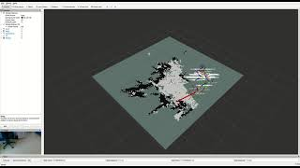
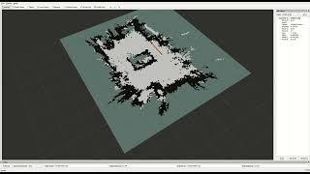
Simulation
Localization
Tracking
Mapping
Understanding
HLoc and RTABMap-ORB SLAM for
building occupancy maps for navigation
Mapping:
Localization:
RTABMap-ORB cannot localize if it starts in a position far from where its last session ended.
Use HLoc as an initial guess for the robot’s pose until RTABMap-ORB can localize.
Adjusted to indoor and evaluator on realistic BROCA indoor data.

Slide 16
Simulation
Localization
Tracking
Mapping
Understanding
Camera calibration
Sparse reconstruction
Dense reconstruction
Monocular depth estimation
Multiview depth estimation

Slide 17
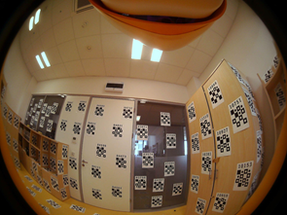
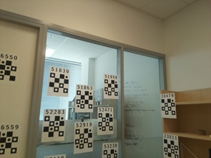
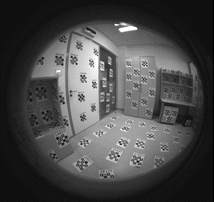
Simulation
Localization
Tracking
Mapping
Understanding
ARI Camera Calibration - calibrate ARI’s cameras into a consistent RIG
ARI has FRONT and BACK 180 deg fisheye cameras (large distortion)
Fish-eye calibration + RIG calibration
Fish-Eye calibration: based on calibration patterns (works but cumbersome)
Image from front fisheye camera of calibration room
RIG Calibration
Calibration room with targets
Bundle Adjustment
Global model in consistent c.s.
Avoid distortion calibration
Use radial cameras (more cams, no undistortion)
P Hruby et al. Four-view geometry with unknown radial distortion. CVPR 2023.
E Martyushev et al. Optimizing Elimination Templates by Greedy Parameter Search. CVPR 2022.
Image from head camera
Image from front torso camera

Slide 18
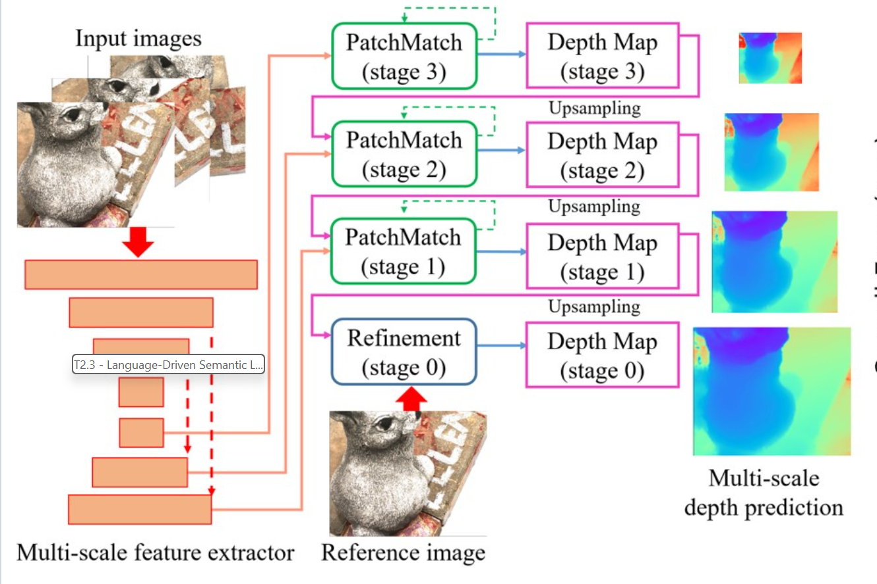
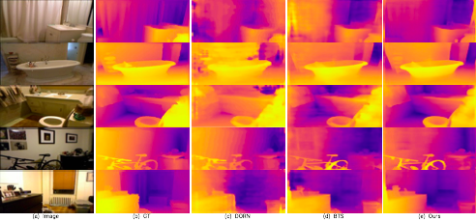
Simulation
Localization
Tracking
Mapping
Understanding
Replace scanned 3D with Single-view depth ``calibrated’’ by sparse SfM from Hloc Rakshith Madhavan. Single View Depth Completion of Sparse 3D Reconstructions. CTU in Prague MSc thesis.2022.
Patchmatchnet: Learned multi-view patchmatch stereo. Wang, F., Galliani, S., Vogel, C., Speciale, P., & Pollefeys, M. Patchmatchnet: Learned multi-view patchmatch stereo. CVPR2021
Example of Single-View Depth estimated from SfM sparse depth measurements

Slide 19
Simulation
Localization
Tracking
Mapping
Understanding
2D images segmentation
3D scene segmentation
LLM

Slide 20
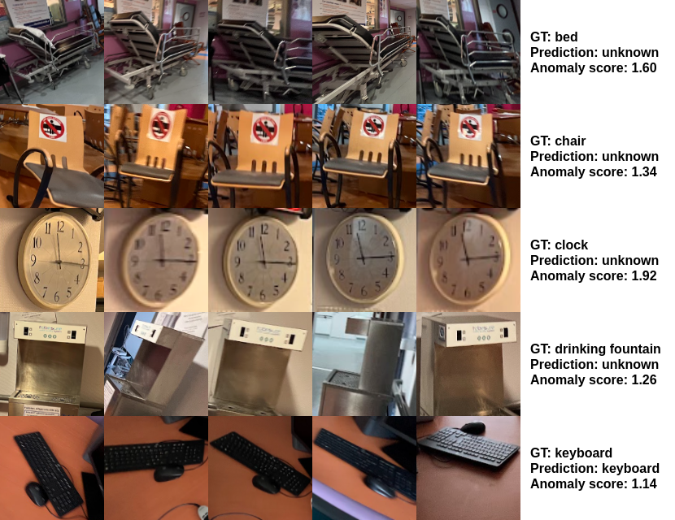
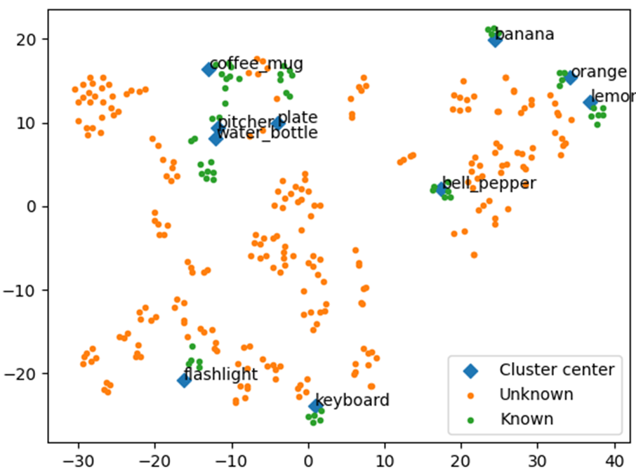
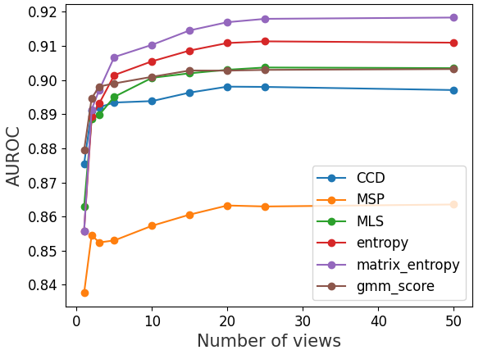
Simulation
Localization
Tracking
Mapping
Understanding
Open-set Multiview Object Classification: AUROC (Open-Set performance) on hospital dataset
Assumes multiple images of a single object.
2D images segmentation by YOLACT trained on MyGYM generated dataset
Images mapped to latent space
Open-Set classification by six anomaly scores
Notes:
6 anomaly scores to detect the object class - known or unknown

Slide 21
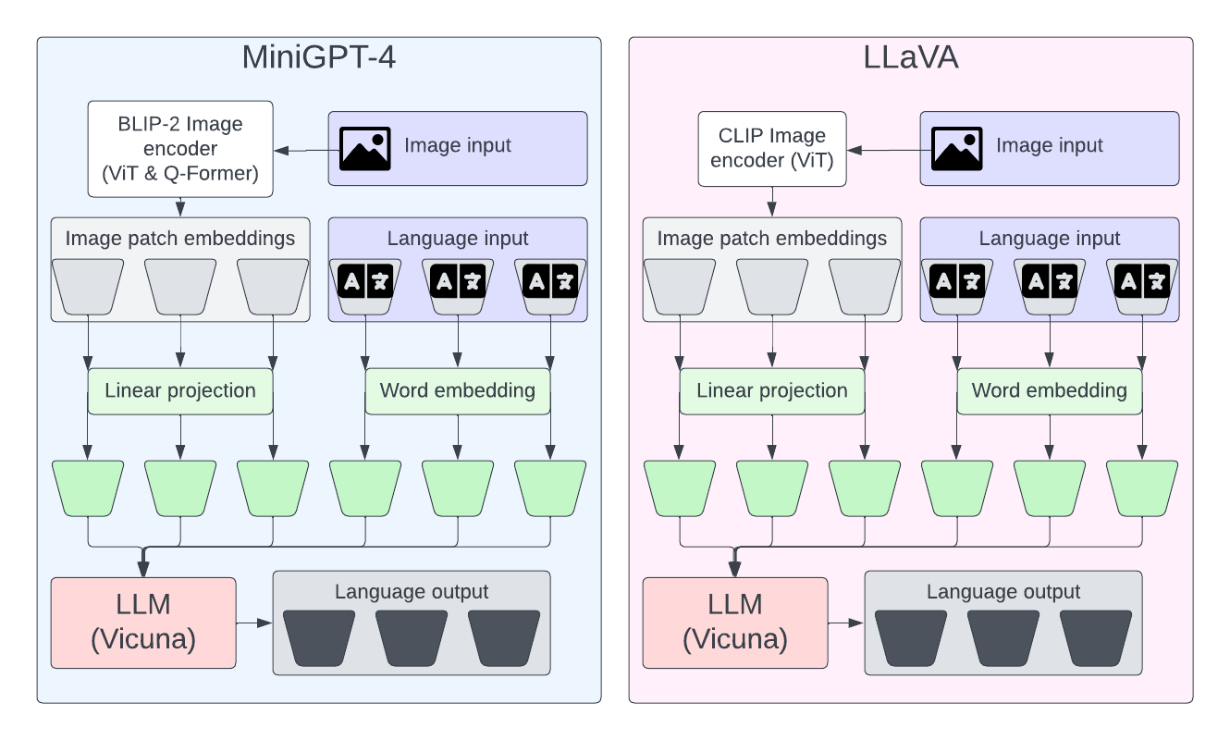
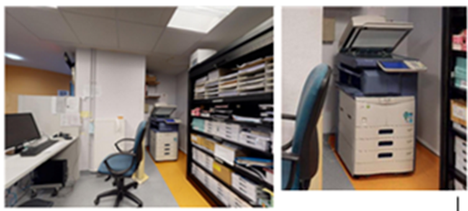
Simulation
Localization
Tracking
Mapping
Understanding
Prompting multimodal LLM’s for Open-Set classification.
Minigpt-4
Zhu, D., Chen, J., Shen, X., Li, X., & Elhoseiny, M. (2023). MiniGPT-4: Enhancing Vision-language ULanguage Models. ArXiv Preprint ArXiv
LLaVA Haotian Liu, Chunyuan Li, Qingyang Wu, and Yong Jae Lee. Visual instruction tuning. arXiv preprint arXiv.
Evaluation of LLM’s on BROCA datasets
(correct answers divided by number of questions)
Undistorted (original and cropped) ARI image from BROCA datasets

Slide 22
Simulation
Localization
Tracking
Mapping
Understanding

Slide 23
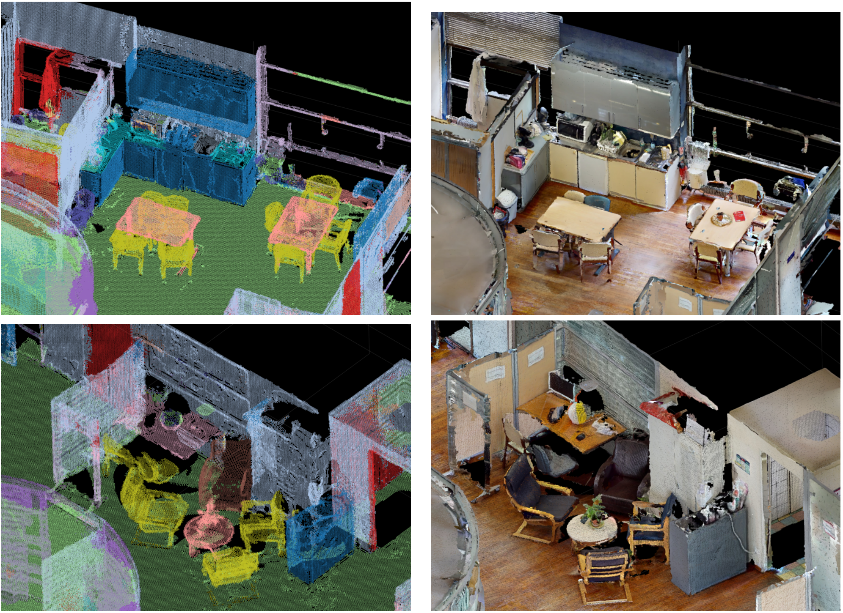
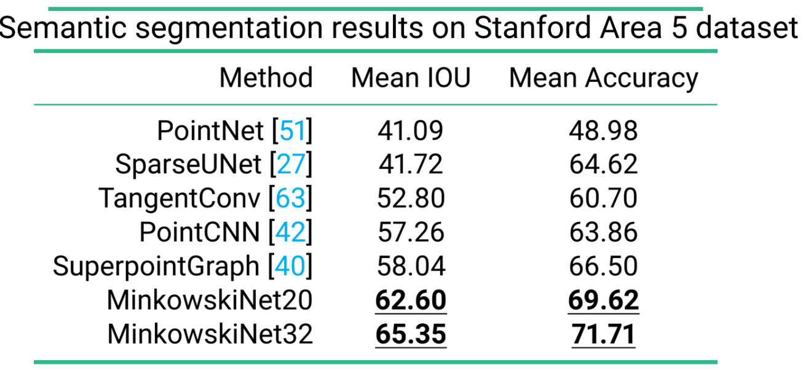
Simulation
Localization
Tracking
Mapping
Understanding
Scene representation for localization: Semantic segmentation of point clouds by Minkowski Engine for sparse tensors and sparse convolution Christopher Choy, JunYoung Gwak, and Silvio Savarese. 4d spatio-temporal convnets: Minkowski convolutional neural networks. CVPR, 2019
Segmentation of static: dense point cloud scene
Segmentation of dynamic: 4D spatio-temporal scenes
Evaluation of Minkowski segmentation on standard datasets from related publication
Qualitative evaluation of Minkowski segmentation on Broca datasets

Slide 24
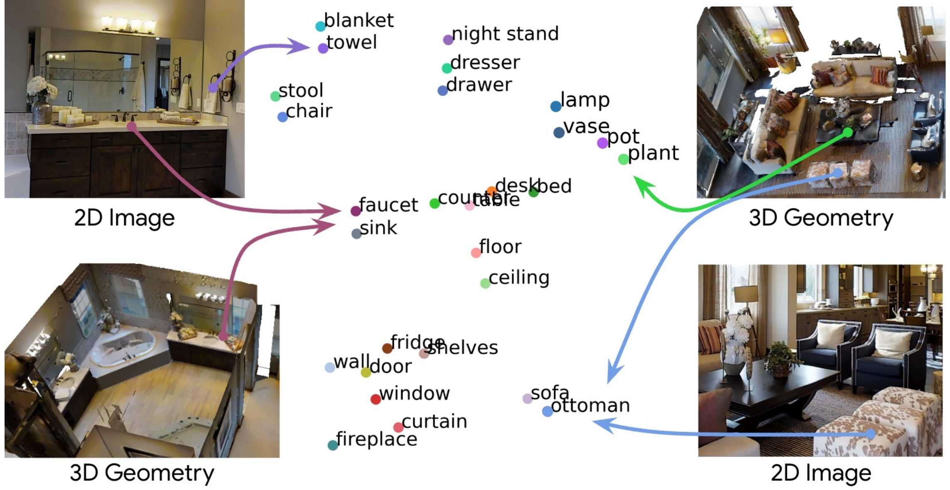
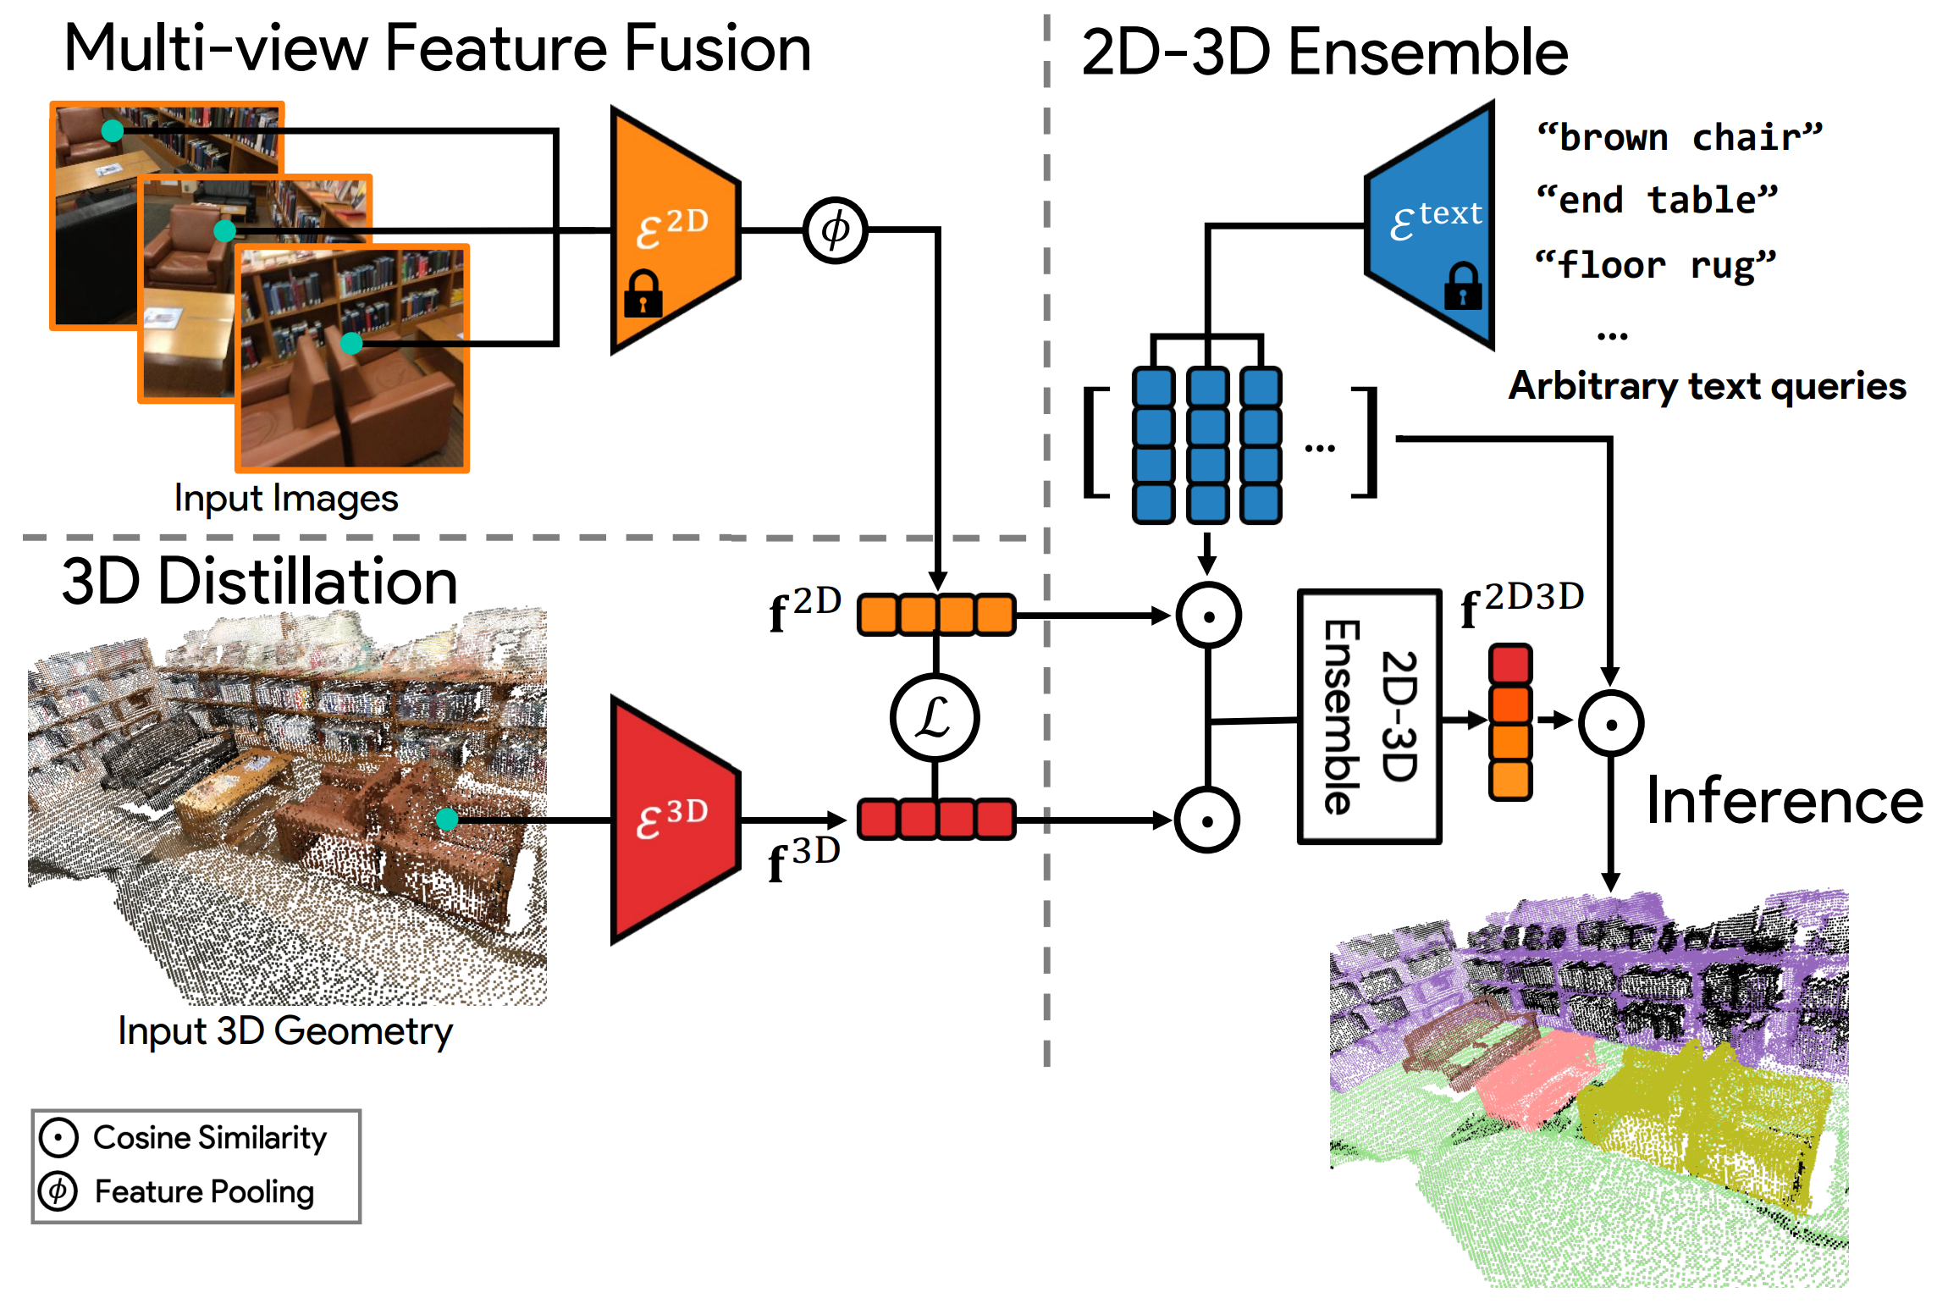
T2.4: Scene Representations for Localization and Mapping
Segmentation of the dense point cloud based on image to text mapping (CLIP feature vectors) distilled for individual pixels Songyou Peng, Kyle Genova, Chiyu “Max” Jiang, Andrea Tagliasacchi, Marc Pollefeys, and Thomas Funkhouser. Openscene: 3d scene understanding with open vocabularies. CVPR2023
The segmentation is trained to provide consistent feature vectors for multiple observations of the same point in 3D, dense point cloud around this point, and the text questions encoded to CLIP feature vectors
Notes:
We tested OpenScene3D, a very recent 3D object embedding algorithm.
The embedding of a dense point cloud and images is based on the image to text mapping. The CLIP feature vectors are distilled for individual pixels in images and 3D points.
The embedding is trained to provide consistent feature vectors for the observations, 3D points, and the text questions.
For any text query (which is transformed to query feature vector), the objects are selected based on cosine similarity between query feature vector and the feature vectors assigned to 2D and 3D points.

Slide 25
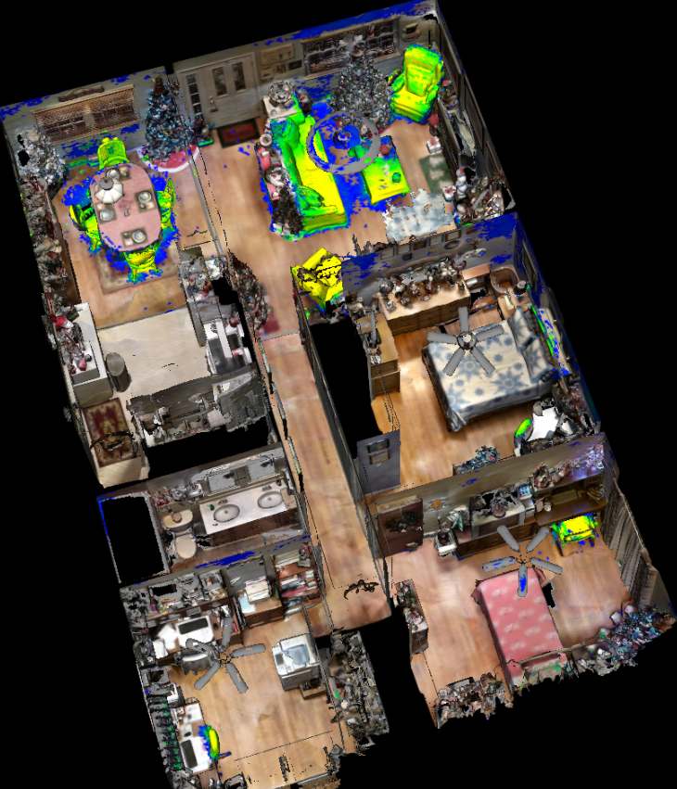
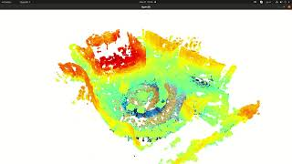
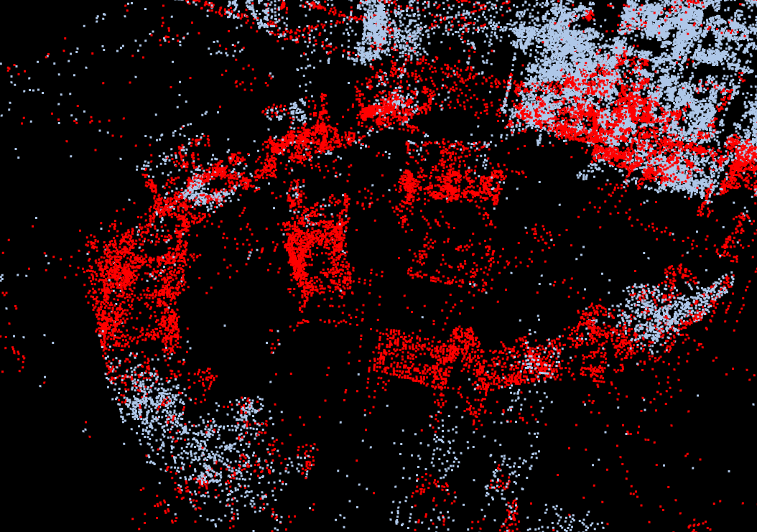
T2.4: Scene Representations for Localization and Mapping
Songyou Peng, Kyle Genova, Chiyu “Max” Jiang, Andrea Tagliasacchi, Marc Pollefeys, and Thomas Funkhouser. Openscene: 3d scene understanding with open vocabularies. CVPR 2023
Kerr, J., Kim, C. M., Goldberg, K., Kanazawa, A., & Tancik, M. (2023). Lerf: Language embedded radiance fields. In Proceedings of the IEEE/CVF International Conference on Computer Vision (pp. 19729-19739).
Standard dataset
Query: "Where can I sit?"
Hospital dataset
Hospital dataset
Notes:
These examples show segmentation based on the embedding OpenScene3D for queries below the images.
The left and the middle figures show the result on standard datasets.
On the right figure we show the results of the pretrained model OpenScene3D on BROCA point cloud extracted from ARI recording.
We see that point cloud we get from ARI are much sparser and performance is worse but still meaningful.
We believe that future retraining will improve this algorithm performance on our data.

Slide 26
Environment Mapping and Self-localisation
Questions?
Notes:
Current Activities and Open Issues

