Slide 1
SPRING – Presentation Winter School WP1 – Experimental Validation February 19, 2024 by ERM Automatismes

Slide 2
Goal
1
Situation, Objectives and Constraints

Slide 3
Situation
One research robot (ARI from PAL Robotics)
Six partners (BIU, CVUT, HWU, INRIA, PAL, UNITN) are creating programmes to enhance the robot's functionalities.
The experiments are carried out by APHP (Broca Living Lab) at Broca Hospital.

Slide 4
Objectives 1
Objectives 2
Provide a hardware and software infrastructure to run the robot programs and record the results
Provide the tools and support to enable APHP to use the robot autonomously over a long period of time
Constraint 1
Constraint 2
The modules added require a higher level of computing power than that of the robot
One feature uses a webservice
A very large volume of data is used
Do not use the hospital network for security reasons
APHP staff have no specific knowledge of IT or development
APHP must validate the data recorded before it is shared.

Slide 5
Solutions
2
Hardware and Software

Slide 6
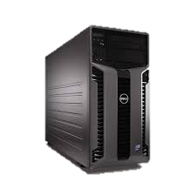
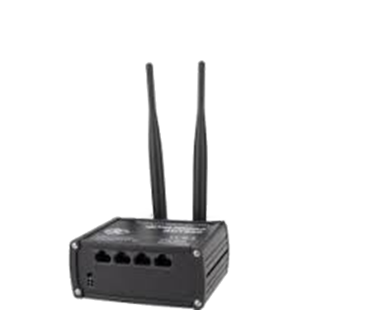
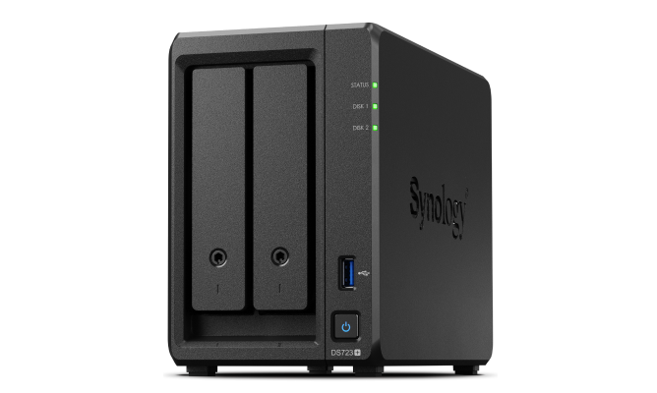
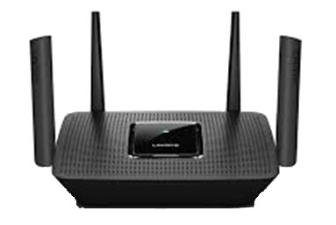
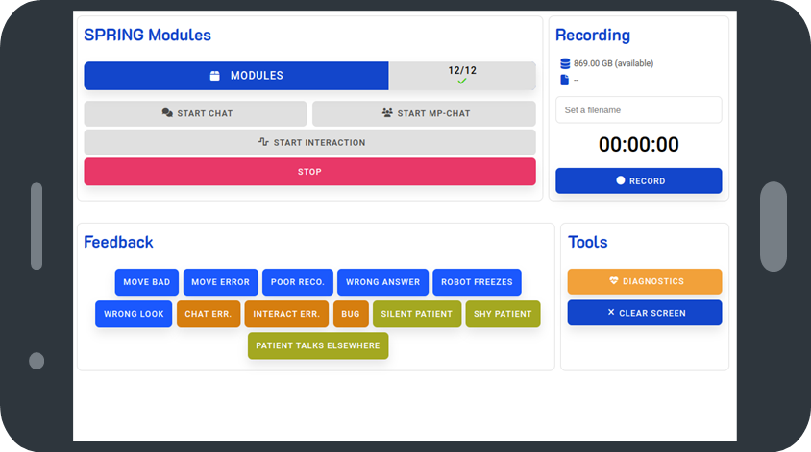
Hardware
Router 4G
Only to be able to use web services. Currently, there is only the dialogue server on Cloud.
Protection by APN (private network without public access), firewall and VPN.
Server (base station)
It relieves the robot by taking charge of the execution of the project's applications.
It has very high computing power.
Router Wi-Fi
This device is dedicated to the system's network communication, so that it can handle the load of data exchanges.
NAS Server
It is used to store large volumes of data. It frees up space on the server.
Tablet Interface
It allows the experimenter to control the system (robot, server, modules) without any technical knowledge.
It also frees up the experimenter's attention, allowing them to concentrate fully on the experiment in hand.

Slide 7
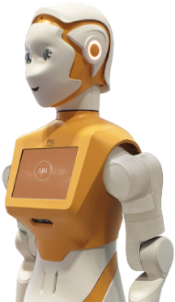
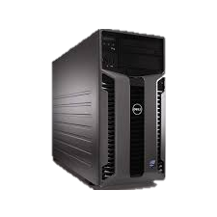
Network
Tablet
Router 4G
Router Wi-Fi robot
Experimenter
Internet
Patients
Dialogue server on HWU cloud
Server NAS
(optional)
Server
(Base Station)
ARI

Slide 8
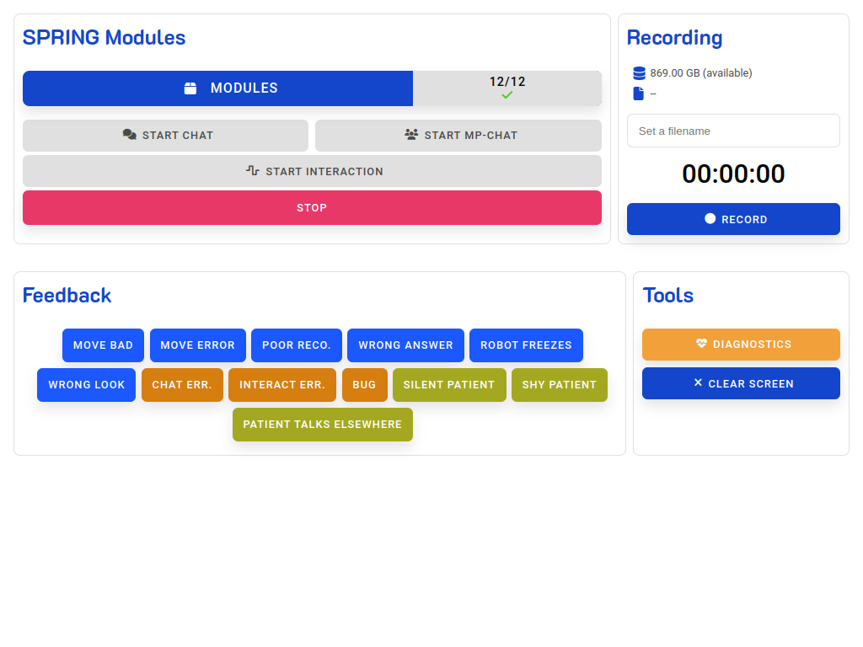
Software : Experimenter Interface
Experimenter Interface
run on tablet
- Controls module startup and shutdown, in order to prepare experiment.
- Command to start dialog and choose type of interaction.
- Easy-to-read view for monitoring robot, server, SPRING module and recording status.
- Annotate recordings
Experimenter Interface server
- Gateway tablet and the modules (running on the robot and server).
- Centralise and format data.
- Manage system commands (Linux) to start programs, read statistics, etc...
- Monitor certain data to trigger alerts on the tablet (diagnostics, activities, Internet connection, tablet presence, etc.).

Slide 9
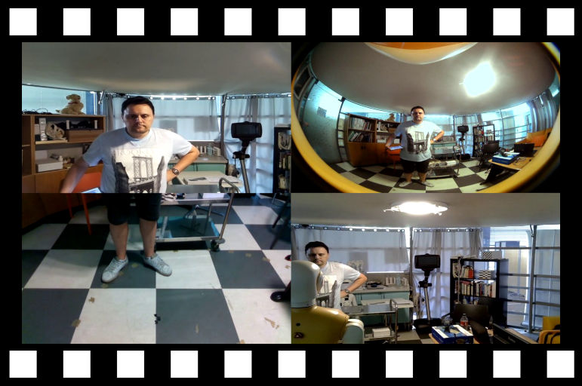
Software : Recording feature
- Run as service on server
- Controlled via the experimenter interface
- Input interface for cutting sequences (censorship)
- List of recordings and their status
- Encoding and censorship in the background
- no CPU usage during experimentation
- export to video for review by APHP
- Recordings can be stored on NAS with automatic transfer and integrity check

Slide 10
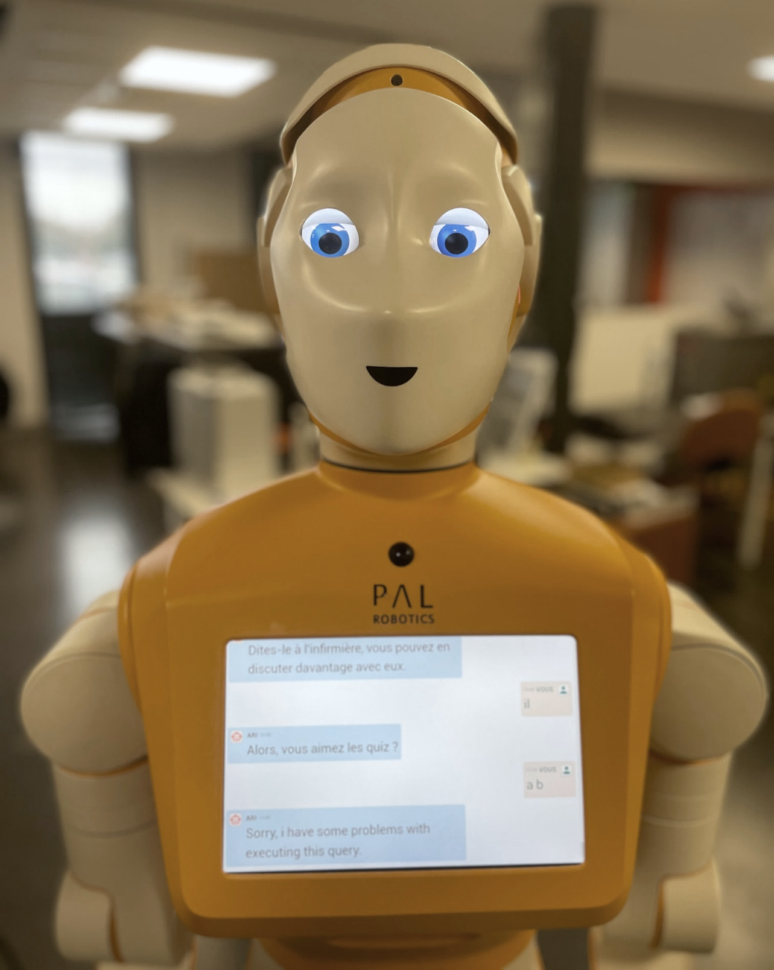
Software : Robot Interaction
Robot eyes display
Replacing motionless generic eyes
- More lifelike eyes with random micro-movements.
- Better aesthetics, less robotics
- Eyelid correction and shifting
- Improved patient acceptance of the robot's appearance
on-board robot display
- used for transcription
- help with comprehension and accessibility

Slide 11
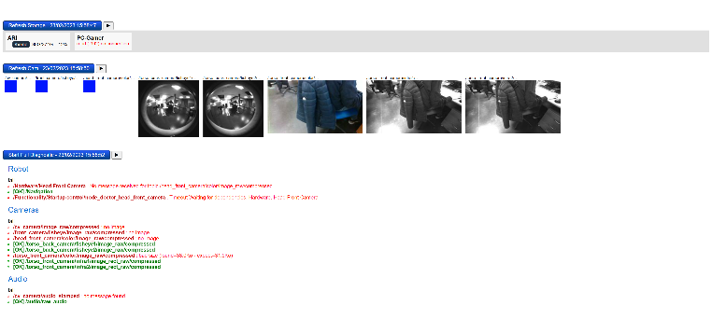
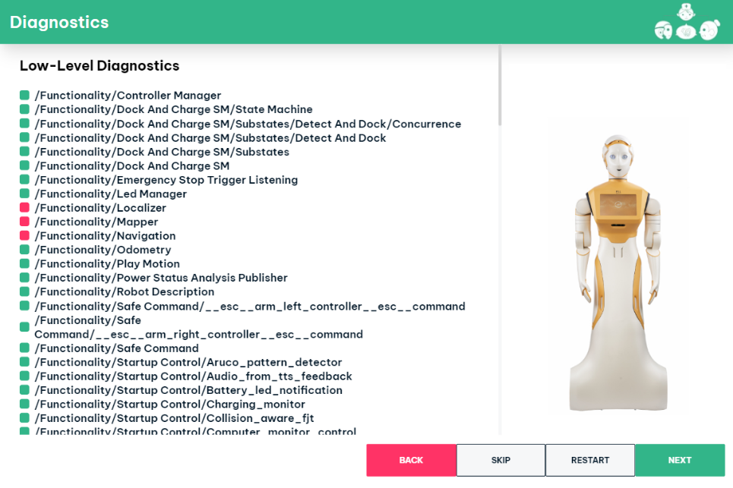
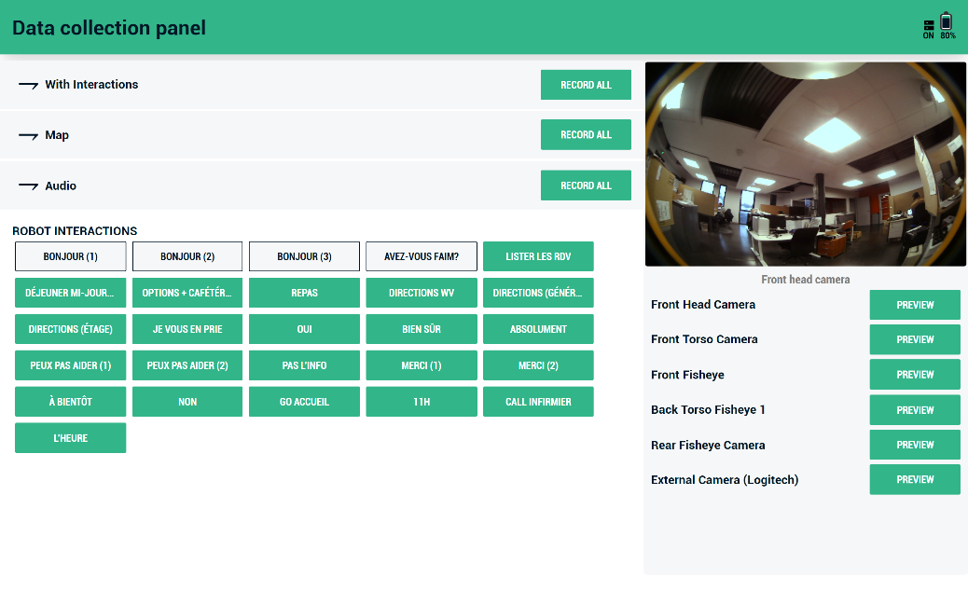
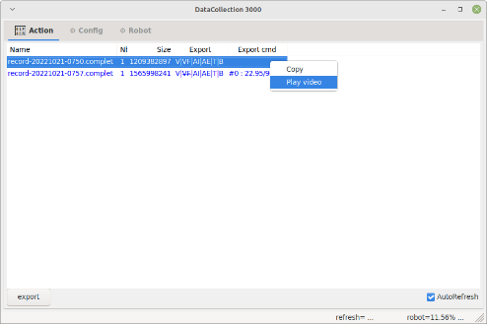
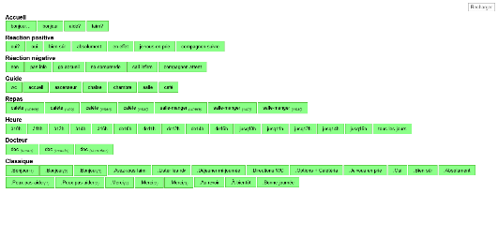
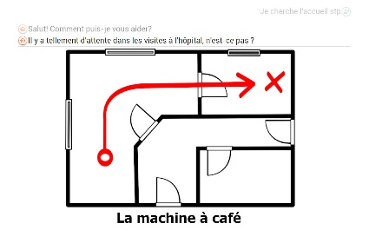
Software : Prototypes and utilities
start-up and diagnostic screen
Manage start-up before modules are fully integrated
- Controls start-up
- Configures modules
- Displays operating status
Data Collection
Acquired the first on-site data before the robot modules were operational
- Robot control in lightweight WoZ
- Recording control
- Creating the conditions for testing functionalities
various utilities
adapted to current versions
- Monitoring
- Reading
- Encoding
- Displaying
- etc.

Slide 12
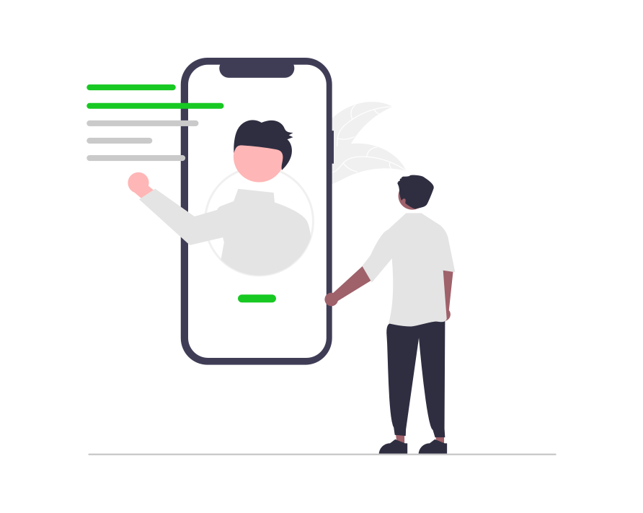
Documentations
Support
- List of IP addresses and communication ports
- Installation procedure (hardware, networking, etc.)
- Start-up procedure (robot, server, software, interfaces, etc.)
- Encoding procedure and data management
- Technical program documentation
- Communication API
- Help with use
- Diagnostics
- Log monitoring
- Updating programs
- Ensuring compliance with ethical rules
- Provision of VPN connections

Slide 13
Thanks!

