Slide 1
SoRAIM (Social Robotics, Artificial Intelligence, and Multimedia) Winter School
Ethics and experimental design
AP-HP
A-S. Rigaud, L Blavette, S Dacunha, M Pino

Slide 2
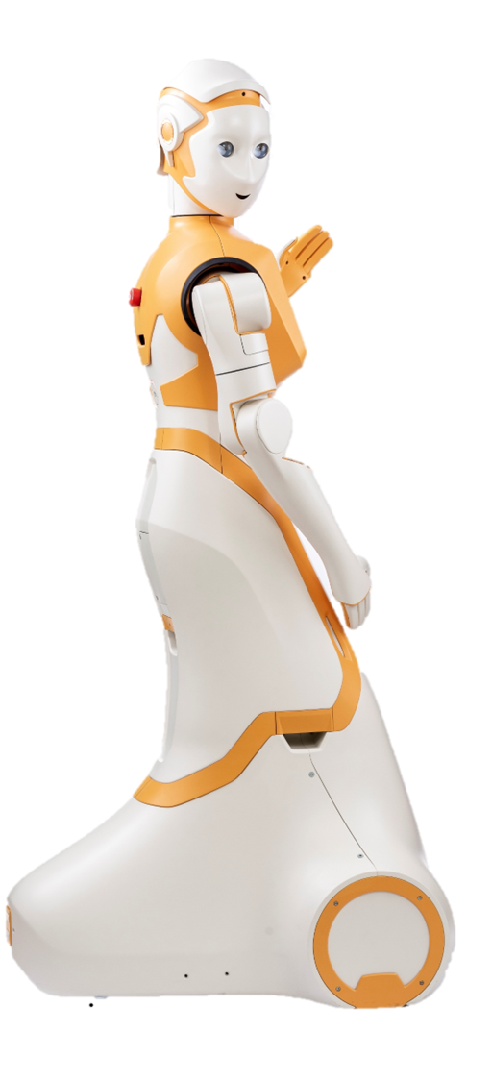
APHP Role and Objectives in the project
To evaluate under controlled and real conditions a set of use cases for the ARI robot in the context of a geriatric hospital.
Acceptability
+
Usability
+
Ethical dimension
+
Performance

Slide 3
The workflow of the research
1
2
Development of the prototype
Day care hospital: Ethnographic research
Experimentation in a simulated environment
Broca Living lab
Experimentation in real environment
Waiting room of the day care hospital
Estimation of acceptability
Understanding of the current organization of care
Study of robot-user interactions
Robustness of scenarios
Acceptability
Study of Robot-User Interactions
Acceptability Assessment
Organizational impact study
Training of professionals

Slide 4
Privacy and Ethics Main objectives and outcomes of WP10
WP10 Objective
Design a set of guidelines to protect the participants and safeguard their personal data during the SPRING experiments
Ensure the compliance of SPRING partners with this framework
WP10 Outcomes
Set of guidelines to ensure ethical compliance for all partners
Follow-up of the actions taken by the partners regarding ethics

Slide 5
3 Deliverables
D10.1: Research involving humans subjects – Requirement 1
Procedures & criteria used to recruit participants
Informed consent procedures & forms
Involvement of vulnerable individuals & measures to protect them
D10.2: Processing of Personal Data (POPD) – Requirement 2
Justification for collecting & processing sensitive personal data
Information of procedure, consent procedures & forms for data collection, storage, protection, retention, and destruction
D10.3: Privacy and Ethics guidelines for experimental validation and data collection
All Documents for handling Ethics and Privacy issues
Identification and approval of all the local and national Ethics committees
GDPR compliance report, of all experimental validation and data collection in the project

Slide 6
Application and validation from ethics committees
PHASE 1. PRELIMINARY STUDY (Broca Living Lab)
University research ethics committee – CER Paris University
Validation obtained and GDPR obtained in February 2021
PHASE 2. FINAL VALIDATION STUDY (Day Hospital)
National research ethics committee – CPP (Through AP-HP Clinical Research and Innovation Department)
Validation obtained in may 2021
ALSO
Proof of approval from INRIA, HWU, BIU, UNITN ethic committees for local experiments (obtained in 2021- 2022)

Slide 7
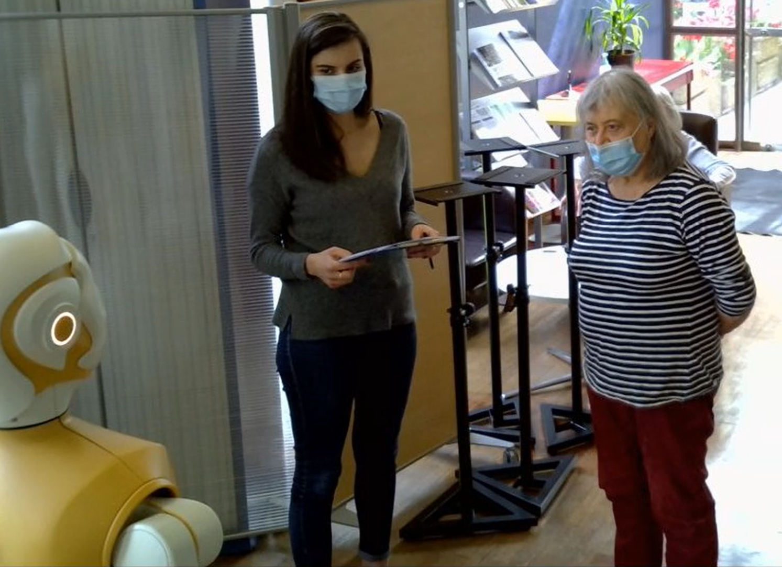
Living Lab Study Simulated environnement Objectives & outcomes
Understand the determinants of acceptance of social robots by users
Test with older adults the robot's functionalities and the scenarios planned for its future implementation → improvement

Slide 8
(1) Older Adults
Over 65 years old;
Have a suﬃcient understanding of French
Without distinction of gender, socio-professional category or ethnic origin
Volunteer to take part in the study
Either former patients or senior volunteers
Participants
(2) Professionals
APHP employees with different positions (administrative, clinical, technical) at the hospital.

Slide 9
Procedure
[Two weeks before experimentation] Recruitment: 1. Verification of eligibility criteria for study participation
2. Call to participant + explanation of project
3. If participant agreed, send the information note
[Day of the experiment]
1. Reminder of the project and signature of consent forms
2. Individual or group sessions (patients and/or carers) with ARI and participants
3. Evaluation questionnaires + interviews with the researcher
Assessment tools
System Usability Scale
Acceptability E-Scale
Interview about ethical issues
Observation grid
Transfer of data to INRIA and partners

Slide 10
Information note
Consent form
Included:
Study and experiment framework
Participant's rights regarding data collection
- Collection of personal data during the experiment, especially audio-visual data
Measures adopted by the consortium regarding the collection, storage, transfer, processing, and dissemination of personal data collected during the experiment
Exploitation of study results by the members of the consortium
Signed in two copies by the investigator ; one copie is given to the participant and the other archived
Included :
Formal agreement to participate
Right to collect personal data during the experimentation
Right to record (audio and video) during the experimentation
Transfer of image rights to the consortium, to allow the exploitation of the recordings.
Signed in two copies (participant and investigator) one copie is given to the participant and the other archived

Slide 11
Day care hospital study Real life environnement Objectives & outcomes
Understand the determinants of acceptance of social robots by users in a real-life hospital setting
Test with older adults and professionals the robot's functionalities and the scenarios planned for its future implementation
→ validation & further improvement

Slide 12
(1) Patients/older adults
Patients attending the day care hospital consultations
Over 65 years old
Understanding French
Without distinction of gender, socio-professional category or ethnic origin
Without severe cognitive disorders (MMSE > 10) or delirium, hallucination
Willing to participate in the study
Participants
Most patients have mild, moderate or severe neurocognitive disorders (Alzheimer’s, dementia). These disorders may be associated to other chronic diseases, disorders and/or disabilities (sensory, motor, mental health…).
Fatigability
Judgment problems
Memory problems
Low self- confidence
- Tests must be short, simple, and facilitated ++++

Slide 13
(2) Accompanying persons (n=100)
Accompanying family members or friends (informal caregivers). Primarily spouses (older adults) or children of patients, also family friends or neighbors
Being over 18 years old
Willing to participate in the study
Participants
Informal caregivers are concerned by the diﬃculties of their loved ones and may also suffer from physical and/or psychological disorders.
Caregiving often involves burden → fatigability, stress, health issues
- Tests must be short, simple, and facilitated ++++
Day - care hospital professionals (n=50)
All categories of professionals involved in the day care hospital context
Being over 18 years old
Willing to participate in the study
High work rates combined with a lack of staff (fatigability, stress)
Feeling obliged to consent to participate in the study (hierarchy)
→ offer a large ﬂexibility of test schedules, encourage freedom of opinion

Slide 14
Procedure
[Two weeks before experimentation] Recruitment: 1. Verification of eligibility criteria for study participation
2. Call to participant + explanation of project
3. If participant agreed, send the information note
[Day of the experiment]
1. Reminder of the project and signature of consent forms
2. Individual or group sessions (patients and/or carers) with ARI and participants
3. Evaluation questionnaires + interviews with the researcher
Assessment tools
System Usability Scale
Acceptability E-Scale
Interview about ethical issues
Observation grid
Transfer of data to INRIA and partners

Slide 15
Limits of legal framework
Robots may challenge the current legal framework of societies where they operate
National and supranational legislation have adapted to ensure the privacy of their citizen (e.g.: GDPR in 2016, applied in 2019)
But some grey areas remain about the use of personal data
CPP although no change of medical care
No answer concerning collection of data in environment with several people

Slide 16
Health Technology Assessment Core Model
Health Problem and Current Use of the Technology (CUR)
Description and technical characteristics of technology (TEC)
Safety (SAF)
Clinical Effectiveness (EFF)
Costs and economic evaluation (ECO)
Ethical analysis (ETH)
Organizational aspects (ORG)
Patients and social aspects (SOC)
Legal aspects (LEG)
Benefit/Harm
Autonomy
Respect
Justice & equity
Legislation
http://www.eunethta.eu/

Slide 17
Participants’ethical concerns
Older adults
Isolation & reduction of human care: robots are supplementary
Deception & manipulation
Unsuitability of technology
Excessive emotional attachment
Privacy issues
Security of data
Replacement of professionals
Professionals
Replacement of professionals by robots
Increase of workload with robots
Responsability for use of robot

Slide 18
Ethical challenges of the use of robots in geriatric settings
Develop robots tailored to the needs and preferences of users
Manage to mitigate the psychological effect of the robot on vulnerable patients.
Ensure the privacy of users regarding personal data’s management and boundaries between private and public.
Limit the negative impacts, both organizational and psychological, of the robot’s presence on the care professional’s daily work.
Inform ethical committees about robotics

